Slide 1
The Domain Name System
3035/GZ01 Networked Systems
Kyle Jamieson
Department of Computer Science
University College London

Slide 2
Today
The Domain Name System (DNS)
DNS security
Coursework 2 introduction

Slide 3
Host names versus IP addresses
Host names (e.g. www.bbc.co.uk)
  Mnemonic name appreciated by humans
  Variable length, full alphabet of characters
  Provide little (if any) information about location
  Examples: www.cnn.com and bbc.co.uk
IP addresses
  Numerical address appreciated by routers
  Fixed length, binary number
  Hierarchical, related to host location

Slide 4
Original design of the DNS
  Per-host file named /etc/hosts
  Flat namespace: each line is an IP address and a name
  SRI (Menlo Park, California) kept the master copy
  Everyone else downloads regularly
But, a single server doesn’t scale
  Traffic implosion (lookups and updates)
  Single point of failure
Need a distributed and hierarchical collection of servers

Slide 5
Domain Name System (DNS)
Hierarchical name space divided into pieces called zones
Zones are distributed over a collection of DNS servers
Hierarchy of DNS servers
  Root servers (identity is hardwired into other servers)
  Top-level domain (TLD) servers
  Authoritative DNS servers
Performing the translations
  Local DNS servers located near clients
  Resolver software running on clients

Slide 6

The DNS namespace is hierarchical
Root:
.
Top-level
Domains (TLDs):
com.
uk.
edu.
ac.uk.
cmu.edu.
mit.edu.
ucl.ac.uk.
Hierarchy of servers follows hierarchy of DNS zones

Slide 7
Many uses of DNS
Hostname to IP address translation
IP address to hostname translation (reverse lookup)
Host name aliasing allows other names for a host
  Can be arbitrarily many aliases
  Alias host names point to canonical hostname
Mail server location
  Lookup zone’s mail server based on zone name
Content distribution networks
  Load balancing among many servers with different IP addresses
  Complex, hierarchical arrangements are possible

Slide 8
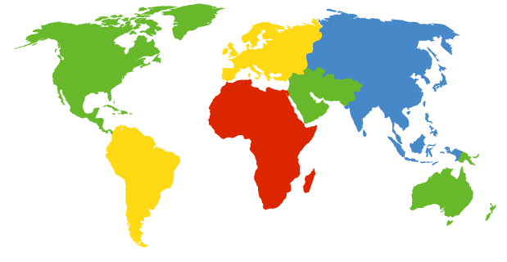
DNS root nameservers
13 root servers (see http://www.root-servers.org)
  Labeled A through M
Does this scale?
A Verisign, Dulles, VA
C Cogent, Herndon, VA
D U Maryland College Park, MD
G US DoD Vienna, VA
H ARL Aberdeen, MD
J Verisign
K RIPE London
I Autonomica, Stockholm
E NASA Mt View, CA
F Internet Software
Consortium
Palo Alto, CA
M WIDE Tokyo
B USC-ISI Marina del Rey, CA
L ICANN Los Angeles, CA
[Slide credit: Scott Shenker]

Slide 9
DNS root nameservers
13 root servers (see http://www.root-servers.org)
  Labeled A through M
Each server is really a cluster of servers (some geographically distributed), replication via IP anycast
A Verisign, Dulles, VA
C Cogent, Herndon, VA (also Los Angeles, NY, Chicago)
D U Maryland College Park, MD
G US DoD Vienna, VA
H ARL Aberdeen, MD
J Verisign (21 locations)
K RIPE London (plus 16 other locations)
I Autonomica, Stockholm (plus 29 other locations)
E NASA Mt View, CA
F Internet Software
Consortium,
Palo Alto, CA
(and 37 other locations)
M WIDE Tokyo
plus Seoul, Paris,
San Francisco
B USC-ISI Marina del Rey, CA
L ICANN Los Angeles, CA
[Slide credit: Scott Shenker]
Notes:
Yes and no – scales to a point, but use IP anycast to replicate further!

Slide 10
TLD and Authoritative Servers
Top-level domain (TLD) servers
  Responsible for com, org, net, edu, etc, and all top-level country domains: uk, fr, ca, jp
  Network Solutions maintains servers for com TLD
  Educause for edu TLD
Authoritative DNS servers
  An organization’s DNS servers, providing authoritative information for organization’s servers
  Can be maintained by organization or service provider

Slide 11
Local name servers
Do not strictly belong to hierarchy
Each ISP (company, university) has one
  Also called default or caching name server
When host makes DNS query, query is sent to its local DNS server
  Acts as proxy, forwards query into hierarchy
  Does work for the client

Slide 12

DNS in operation
Most queries and responses are UDP datagrams
Two types of queries:
Recursive:
Iterative:
www.scholarly.edu?
Client
NS
Answer: www.scholarly.edu A 10.0.0.1
www.scholarly.edu?
Client
NS
Referral: .edu NS 10.2.3.1

Slide 13
A recursive DNS lookup (simplified)
. (root) authority 198.41.0.4
edu.: NS 192.5.6.30
no.: NS 158.38.8.133
uk.: NS 156.154.100.3
edu. authority 192.5.6.30
scholarly.edu.: NS 12.35.1.1
pedantic.edu.: NS 19.31.1.1
www.scholarly.edu?
Contact 192.5.6.30 for edu.
www.scholarly.edu?
Contact 12.35.1.1 for scholarly.edu.
www.scholarly.edu?
scholarly.edu. authority 12.35.1.1
www.scholarly.edu.: A 12.35.2.30
imap.scholarly.edu.: A 12.35.2.31
Client
. (root): NS 198.41.0.4
edu.: NS 192.5.6.30
scholarly.edu.: NS 12.35.1.1
www.scholarly.edu.: A 12.35.51.30
Notes:
Client is doing a lookup for www.scholarly.edu

Slide 14
Local NS does clients’ work
Root NS
Client’s resolver makes a recursive query to local NS
Local NS processing:
  Local NS sends iterative queries to other NS’s
  or, finds answer in cache
Local NS responds with an answer to the client’s request
TLD NS
Local
NS
Authoritative NS
Clients

Slide 15
Recursive versus iterative queries
Recursive query
Iterative query
Less burden on client
More burden on nameserver (has to return an answer to the query)
Most root and TLD servers will not answer (shed load)
  Local name server answers recursive query
More burden on client
Less burden on nameserver (simply refers the query to another server)

Slide 16
DNS resource record (RR): Overview
DNS is a distributed database storing resource records
RR includes: (name, type, value, time-to-live)
Type = A (address)
  name is hostname
  value is IP address
Type = NS (name server)
  name is domain (e.g. cs.ucl.ac.uk)
  value is hostname of authoritative name server for this domain
Type = CNAME
  name is an alias for some “canonical” (real) name
  e.g. www.cs.ucl.ac.uk is really haig.cs.ucl.ac.uk
  value is canonical name
Type = MX (mail exchange)
  value is name of mail server associated with domain name
  pref field discriminates between multiple MX records
Notes:
A records do the work of DNS.
NS records form the links in the hierarchy, pointing to other name servers.
CNAMEs make aliases.
MXs point to email servers.

Slide 17
Example: A real recursive query
$ dig @a.root-servers.net www.freebsd.org +norecurse
; <<>> DiG 9.4.3-P3 <<>> @a.root-servers.net www.freebsd.org +norecurse
; (1 server found)
;; global options: printcmd
;; Got answer:
;; ->>HEADER<<- opcode: QUERY, status: NOERROR, id: 57494
;; flags: qr; QUERY: 1, ANSWER: 0, AUTHORITY: 6, ADDITIONAL: 12
;; QUESTION SECTION:
;www.freebsd.org. IN A
;; AUTHORITY SECTION:
org. 172800 IN NS b0.org.afilias-nst.org.
org. 172800 IN NS d0.org.afilias-nst.org.
;; ADDITIONAL SECTION:
b0.org.afilias-nst.org. 172800 IN A 199.19.54.1
d0.org.afilias-nst.org. 172800 IN A 199.19.57.1
;; Query time: 177 msec
;; SERVER: 198.41.0.4#53(198.41.0.4)
;; WHEN: Wed Oct 28 07:32:02 2009
;; MSG SIZE rcvd: 435
“Glue” record

Slide 18
Example: A real recursive query (2)
$ dig @199.19.54.1 www.freebsd.org +norecurse
; <<>> DiG 9.4.3-P3 <<>> @a0.org.afilias-nst.org www.freebsd.org +norecurse
; (1 server found)
;; global options: printcmd
;; Got answer:
;; ->>HEADER<<- opcode: QUERY, status: NOERROR, id: 39912
;; flags: qr; QUERY: 1, ANSWER: 0, AUTHORITY: 3, ADDITIONAL: 0
;; QUESTION SECTION:
;www.freebsd.org. IN A
;; AUTHORITY SECTION:
freebsd.org. 86400 IN NS ns1.isc-sns.net.
freebsd.org. 86400 IN NS ns2.isc-sns.com.
freebsd.org. 86400 IN NS ns3.isc-sns.info.
;; Query time: 128 msec
;; SERVER: 199.19.56.1#53(199.19.56.1)
;; WHEN: Wed Oct 28 07:38:40 2009
;; MSG SIZE rcvd: 121
No glue record provided for ns1.isc-sns.net, so need to go off and resolve (not shown here), then restart the query

Slide 19
Example: A real recursive query (3)
$ dig @ns1.isc-sns.net www.freebsd.org +norecurse
; <<>> DiG 9.4.3-P3 <<>> @ns1.isc-sns.net www.freebsd.org +norecurse
; (1 server found)
;; global options: printcmd
;; Got answer:
;; ->>HEADER<<- opcode: QUERY, status: NOERROR, id: 17037
;; flags: qr aa; QUERY: 1, ANSWER: 1, AUTHORITY: 3, ADDITIONAL: 5
;; QUESTION SECTION:
;www.freebsd.org. IN A
;; ANSWER SECTION:
www.freebsd.org. 3600 IN A 69.147.83.33
;; AUTHORITY SECTION:
freebsd.org. 3600 IN NS ns2.isc-sns.com.
freebsd.org. 3600 IN NS ns1.isc-sns.net.
freebsd.org. 3600 IN NS ns3.isc-sns.info.
;; ADDITIONAL SECTION:
ns1.isc-sns.net. 3600 IN A 72.52.71.1
ns2.isc-sns.com. 3600 IN A 38.103.2.1
ns3.isc-sns.info. 3600 IN A 63.243.194.1

Slide 20
DNS Caching
Performing all these queries takes time
  And all this before actual communication takes place
  e.g., one-second latency before starting Web download
Caching can greatly reduce overhead
  The top-level servers very rarely change
  Popular sites (e.g., www.cnn.com) visited often
  Local DNS server often has the information cached
How DNS caching works
  DNS servers cache responses to queries
  Responses include a time-to-live (TTL) field
  Server deletes cached entry after TTL expires
[Slide credit: Scott Shenker]

Slide 21
Reverse mapping (IP to hostname)
How do we go the other direction, from an IP address to the corresponding hostname?
  Why do we care to? Troubleshooting, security, spam
IP address already has natural “quad” hierarchy: 12.34.56.78
But: IP address has most-significant hierarchy element on the left, while www.cnn.com has it on the right
Idea: reverse the quads = 78.56.34.12, and look that up in the DNS
Under what top-level domain?
  Convention: in-addr.arpa
  So lookup is for 78.56.34.12.in-addr.arpa

Slide 22
Inserting resource records into DNS
Example: just created startup “FooBar”
Get a block of address space from ISP, say 212.44.9.128/25
Register foobar.com at Network Solutions (say)
  Provide registrar with names and IP addresses of your authoritative name server (primary and secondary)
  Registrar inserts RR pairs into the com TLD server:
    (foobar.com, dns1.foobar.com, NS)
    (dns1.foobar.com, 212.44.9.129, A)
Put in your (authoritative) server dns1.foobar.com:
  Type A record for www.foobar.com
  Type MX record for foobar.com
[Slide credit: Scott Shenker]

Slide 23
Setting up foobar.com (cont’d)
In addition, need to provide reverse PTR bindings
  e.g., 212.44.9.129 → dns1.foobar.com
Normally, these would go in 9.44.212.in-addr.arpa
Problem: you can’t run the name server for that domain. Why not?
  Because your block is 212.44.9.128/25, not 212.44.9.0/24
  And whoever has 212.44.9.0/25 won’t be happy with you owning their PTR records
Solution: ISP runs it for you, but it’s more of a headache to keep it up-to-date :-(
[Slide credit: Scott Shenker]

Slide 24
DNS protocol operation
Most queries and responses via UDP, server port 53
Source IP
IP header
Destination IP
Source port
Dest port
UDP header
UDP length
UDP cksum
Query ID
QR
opcode
AA
TC
RD
RA
Z
rcode
DNS payload

Slide 25
DNS server state
UDP socket listening on port 53
10.0.0.3
10.0.0.1
10.0.0.3
10.1.0.1
10.0.0.3
10.1.0.1
33001
53
33001
53
Client
10.0.0.1
11001
53
UDP length
UDP cksum
TLD NS
10.1.0.1
UDP length
UDP cksum
UDP length
UDP cksum
23001
QR
opcode
AA
TC
RD
RA
Z
rcode
11
QR
opcode
AA
TC
RD
RA
Z
rcode
23001
QR
opcode
AA
TC
RD
RA
Z
rcode
Local NS
10.0.0.3
10.2.0.1
10.0.0.3
10.0.0.2
10.0.0.3
10.2.0.1
10.0.0.3
53
33002
UDP length
UDP cksum
22002
53
33002
53
Client
10.0.0.2
UDP length
TLD NS
10.2.0.1
23002
UDP cksum
UDP length
UDP cksum
QR
opcode
AA
TC
RD
RA
Z
rcode
22
QR
opcode
AA
TC
RD
RA
Z
rcode
23002
QR
opcode
AA
TC
RD
RA
Z
rcode
Local NS at least needs to keep state associating
Query ID → which query (if any)

Slide 26
A DNS resource record (RR) in detail
type: determines the meaning of rdata
class: always IN (Internet)
rdata: data associated with the RR
1
0
0
1
2
3
4
5
6
7
8
9
1
2
3
4
5
name (variable length)
type
class
ttl
rdlength
rdata (variable length)

Slide 27
DNS protocol message
Query and reply messages have identical format
Question section: query for name server
Answer section: RRs answering the question
Authority section: RRs that point to an authoritative NS
Additional section: “glue” RRs
Header
Question section
Answer section
RR
RR
Authority section
RR
RR
Additional section
RR
RR

Slide 28
DNS protocol header
Query ID: 16-bit identifier shared between query, reply
Flags word
  QR: query (0) or response (1)
  opcode: standard query (0)
  AA: authoritative answer
  TC: truncation
  RD: Recursion desired
  RA: Recursion available
  Z: (reserved and zeroed)
  rcode: response code; ok (0)
qdcount: number of question entries (QEs) in message
ancount: number of RRs in the answer section
nscount: number of RRs in the authority section
arcount: number of RRs in the additional section
1
0
0
1
2
3
4
5
6
7
8
9
1
2
3
4
5
Query ID
QR
opcode
AA
TC
RD
RA
Z
rcode
qdcount
ancount
nscount
arcount
Notes:
Query id must match request in order for DNS server to accept a reply.

Slide 29
Today
The Domain Name System (DNS)
DNS security
Coursework 2 introduction

Slide 30
Implications of subverting DNS
Redirect victim’s web traffic to rogue servers
Redirect victim’s email to rogue email servers (MX records in DNS)
Does Secure Sockets Layer (SSL) provide protection?
  Yes―user will get “wrong certificate warnings” if SSL is enabled
  No―SSL not enabled or user ignores warnings
  No―how is SSL trust established? Often, by email!

Slide 31
Security Problem #1: Coffee shop
As you sip your latte and surf the Web, how does your laptop find google.com?
Answer: it asks the local DNS nameserver
  Which is run by the coffee shop or their contractor
  And can return to you any answer they please
  Including a “man in the middle” site that forwards your query to Google, gets the reply to forward back to you, yet can change anything they wish in either direction
How can you know you’re getting correct data?
  Today, you can’t. (Though if site is HTTPS, that helps)
  One day, hopefully: DNSSEC extensions to DNS

Slide 32
Security Problem #2: Cache poisoning
Suppose you are evil and you control the name server for foobar.com. You receive a request to resolve www.foobar.com and reply:
;; QUESTION SECTION:
;www.foobar.com. IN A
;; ANSWER SECTION:
www.foobar.com. 300 IN A 212.44.9.144
;; AUTHORITY SECTION:
foobar.com. 600 IN NS dns1.foobar.com.
foobar.com. 600 IN NS google.com.
;; ADDITIONAL SECTION:
google.com. 5 IN A 212.44.9.155
Evidence of the attack disappears 5 seconds later!
A foobar.com machine, not google.com

Slide 33
DNS cache poisoning (cont’d)
Okay, but how do you get the victim to look up www.foobar.com in the first place?
Perhaps you connect to their mail server and send
  HELO www.foobar.com
  Which their mail server then looks up to see if it corresponds to your source address (anti-spam measure)
Note, with compromised name server we can also lie about PTR records (address → name mapping)
  e.g., for 212.44.9.155 = 155.44.9.212.in-addr.arpa return google.com (or whitehouse.gov, or whatever)
    If our ISP lets us manage those records as we see fit, or we happen to directly manage them

Slide 34
Bailiwick checking
DNS resolver ignores all RRs not in or under the same zone as the question
Widely deployed since ca. 1997
;; QUESTION SECTION:
;www.foobar.com. IN A
;; ANSWER SECTION:
www.foobar.com. 300 IN A 212.44.9.144
;; AUTHORITY SECTION:
foobar.com. 600 IN NS dns1.foobar.com.
foobar.com. 600 IN NS google.com.
;; ADDITIONAL SECTION:
google.com. 5 IN A 212.44.9.155

Slide 35
Poisoning the local nameserver
Let’s get more sophisticated and try to target the local nameserver instead of a single client
When does the nameserver accept a reply?
  Reply’s dest. UDP port = query’s source UDP port
  Matching question section
  Matching (16-bit) query IDs
So if the bad guy can achieve the above, he can inject incorrect data into a nameserver’s cache
  Let’s see how
Notes:
Also: Authority and additional sections represent names that are within the same domain as the question.

Slide 36
Predicting the next query ID
Root NS
TLD NS
Next query ID = Query ID + 1
Source port
Dest port
UDP length
UDP cksum
Query ID
QR
opcode
AA
TC
RD
RA
Z
rcode
…
Victim
NS
Bad guy’s network
ns.badguy.com?
www.badguy.com?
ns.badguy.com
Clients
Notes:
Query ID role: must match request and reply.
Back in the day DNS servers used consecutive query IDs (sensible thing to do).
So bad guy can now make a request to the victim NS for something in his domain and get a rough idea of current query ID.

Slide 37
Nameserver cache poisoning
Root NS
TLD NS
Barclay’s NS
Legitimate IP of
www.barclays.co.uk,
QID = 5001
www.barclays.co.uk?
QID = 5001
Victim
NS
www.barclays.co.uk?
IP = bad guy’s IP, QID = 5001
IP = bad guy’s IP, QID = 5002
Bad guy
IP = bad guy’s IP, QID = 5003
…
Clients
Notes:
Now bad guy has rough idea of query ID.
Assume nameserver allows outside queries from the bad guy.
Bad guy asks for www.barclays.co.uk

Slide 38
Requirements for a successful exploit
Attacker has to know the UDP source port the victim NS sent the query on (otherwise UDP drops the forged reply)
  ca. 2008, most NSs used a well-known source port!
Attacker has to correctly guess the 16-bit Query ID
  Countermeasure: name servers now use pseudorandom query IDs
  Although, older servers used an easily-guessable pseudorandom number generator
Forged replies have to arrive first
Name can’t already be in victim’s cache
Forged reply passes the bailiwick check (trivial)

Slide 39
Kaminsky nameserver poisoning
Now let’s assume the nameserver uses query ID randomization
Two main ideas behind Kaminsky DNS cache poisoning:
Compromise an entire domain instead of just an IP
  Now the attacker targets the glue records
Launch multiple (K) simultaneous uncached queries to increase odds of success, for example:
  www123.barclays.co.uk
  www1234.barclays.co.uk
  www12345.barclays.co.uk

Slide 40
Kaminsky nameserver poisoning (1): One query
barclays.co.uk NS ns1.barclays.co.uk
ns1.barclays.co.uk A 10.0.0.1
ns.co.uk
ns1.barclays.co.uk
10.0.0.1
Root NS
www123.barclays.co.uk?
QID = 3817
Bad guy’s network
Victim
NS
ns1.badguy.com
10.2.0.2
www123.barclays.co.uk?
ns1.barclays.co.uk A 10.2.0.2 QID = 39183
ns1.barclays.co.uk A 10.2.0.2 QID = 9284
ns1.barclays.co.uk A 10.2.0.2 QID = 1932
Clients
Bad guy
Notes:
Let’s look at one query
Bad guy asks for www123.barclays.co.uk
Injects responses with random query IDs.
Glue records associate legit NS with bad guy’s IP.

Slide 41
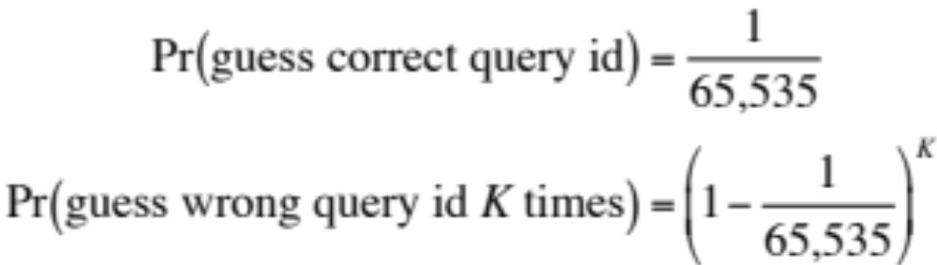
Kaminsky nameserver poisoning (2)
Now how likely is this attack to work?
  The attacker is successful if he does not guess the wrong query ID K times
K | Pr(guess wrong query id K times)
4 | 0.99994
40 | 0.9994
400 | 0.994
4,000 | 0.94
40,000 | 0.54

Slide 42
Kaminsky nameserver poisoning (3)
Multiple queries and replies
Legitimate NS is now cached in the victim NS, but victim NS still makes requests for new random names
Attacker injects responses with bogus glue records!
ns1.barclays.co.uk
10.0.0.1
www123.barclays.co.uk?
www1234.barclays.co.uk?
Victim
NS
…
Bad guy’s network
ns1.badguy.com
10.2.0.2
www123.barclays.co.uk?
ns1.barclays.co.uk A 10.2.0.2 QID = 39183
www1234.barclays.co.uk?
…
ns1.barclays.co.uk A 10.2.0.2 QID = 715
…
Clients
Notes:
Now subsequently the legit NS is cached in the victim NS.
But victim NS still asks the target domain’s NS for the random names.
Inject responses with bogus glue records.

Slide 43
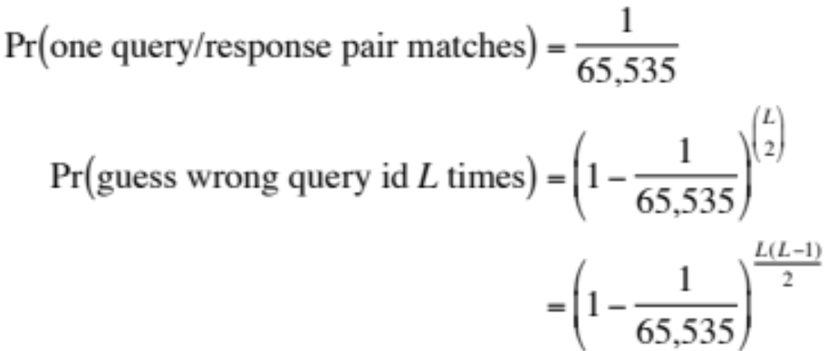
Increasing the chances of success
Suppose we send a burst of L queries and L forged responses
  Random query IDs everywhere
In practice, takes about
10 minutes
L | Pr(Every forgery wrong)
10 | 0.9994
100 | 0.926
290 | 0.54

Slide 44
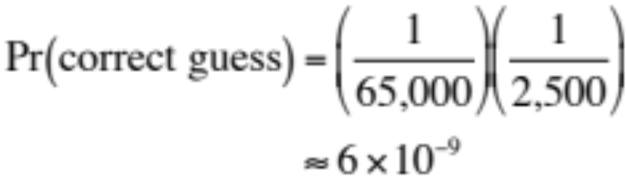
Mitigating nameserver poisoning
Solution: Randomize the query’s UDP source port
Reply checking:
  Kernel network stack matches destination port of TLD server’s reply with UDP source port of local NS’s query
  DNS server matches query ID of reply with query id of request
MS DNS server pre-allocates
2,500 UDP ports for requests
Source IP
Destination IP
Source port
Dest port
UDP length
UDP cksum
Query ID
QR
opcode
AA
TC
RD
RA
Z
rcode
Notes:
Or use DNSSEC.

Slide 45
Today
The Domain Name System (DNS)
DNS security
Coursework 2 introduction

