Slide 1
ScanComplete
Large-Scale Scene Completion and Semantic Segmentation for 3D Scans
CVPR ’18 (right now!)
Angela Dai^{1,3,5} Daniel Ritchie² Martin Bokeloh³ Scott Reed⁴ Juergen Sturm³ Matthias Nießner⁵
¹Stanford University ²Brown University ³Google ⁴DeepMind ⁵Technical University of Munich

Slide 2
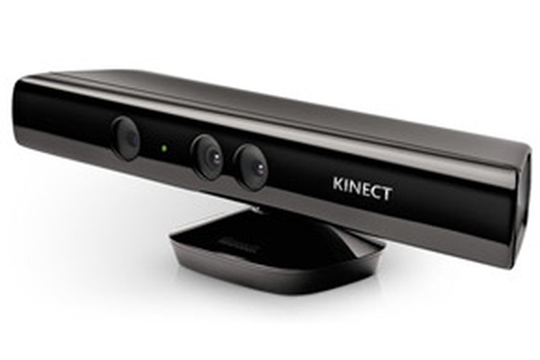
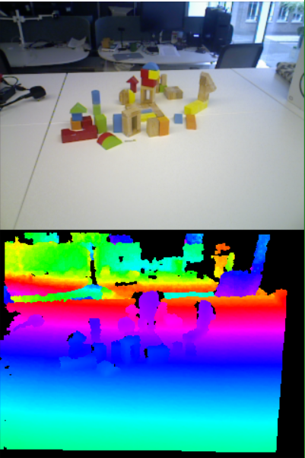
Background: Dense RGBD SLAM
RGBD Cameras
Per-pixel RGB & depth output
Structured IR light/Time of flight
Enables dense 3D geometric reconstruction
Kinect Fusion (2011)
Kinect – affordable, high resolution
GPGPU
Real-time, dense 3D reconstruction
More recent approaches:
Kintinuous (larger volumes)
ElasticFusion (loop closure)
Co-Fusion (tracking multiple objects)

Slide 3
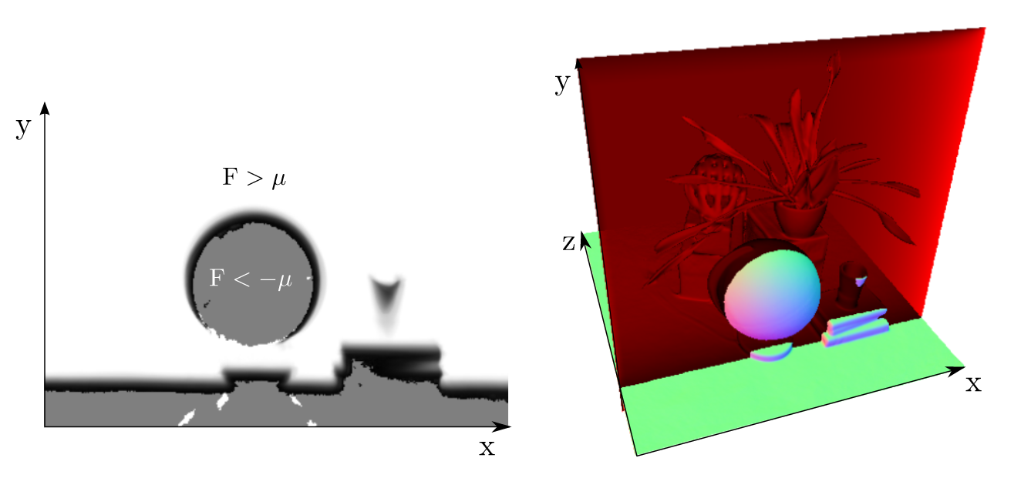
Background: Dense RGBD SLAM
Reconstruction
General approach
Scene representation (e.g. voxels, surfels)
Track camera against scene representation
Integrate new data into representation
Voxel-based representations
Samples of implicit function on regular cubic grid
Distance fields typically used
Truncated signed distance fields (TSDFs)
Truncated: distances above threshold not stored
Signed: sign indicates behind/in front of surface
Captured RGBD
Frames
Predicted RGBD
Frames
Camera Pose
KinectFusion: Real-time dense surface mapping and tracking (Newcombe et al. ISMAR 2011)

Slide 4
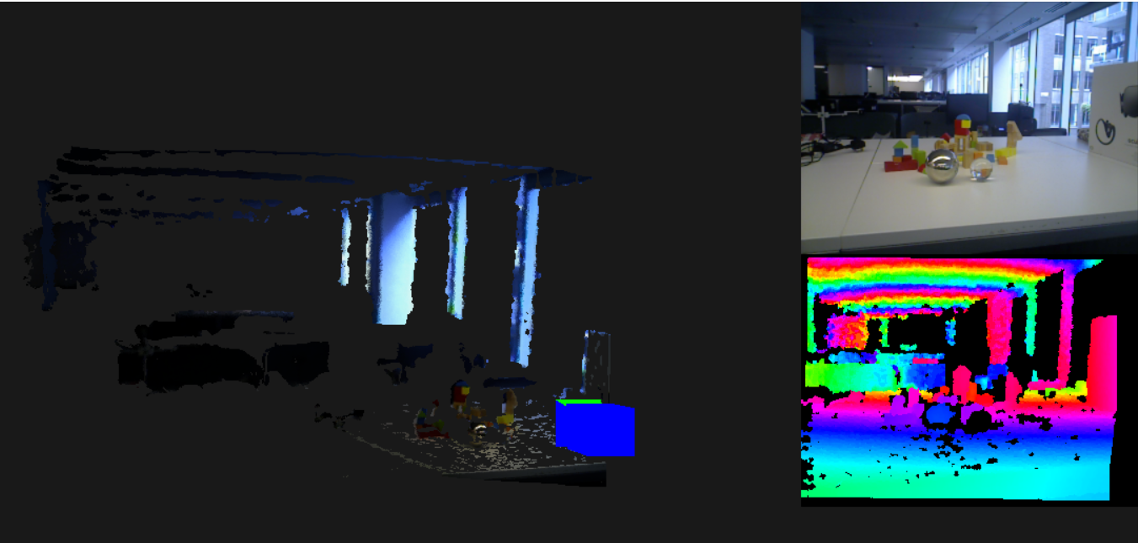
Dense RGBD SLAM: Practical Issues
Creating a complete scan of a real room is hard:
Limited depth range of sensor
Missing depths
Shiny materials
Translucent materials
Shallow angles
Time required to scan whole room
Tracking loss on flat, featureless surfaces
Most scans are incomplete
800mm
4000mm

Slide 5
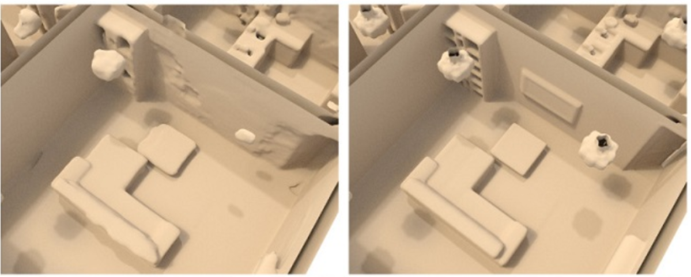
Completing 3D Scans
Input
Poisson Surface Reconstruction
Traditional approaches
Poisson surface reconstruction
Laplacian hole filling
Limited quality:
Filling small holes is possible
Cannot infer details not present in input
Machine learning
Capable of adding missing detail
Semantic information important
ScanComplete
Ground Truth

Slide 6
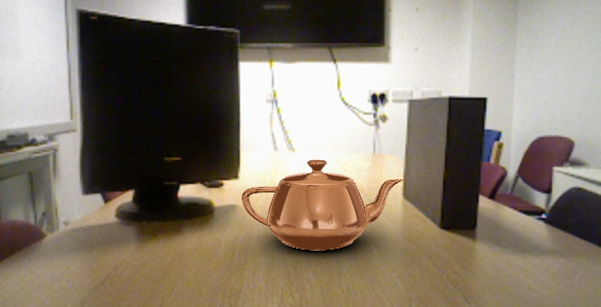
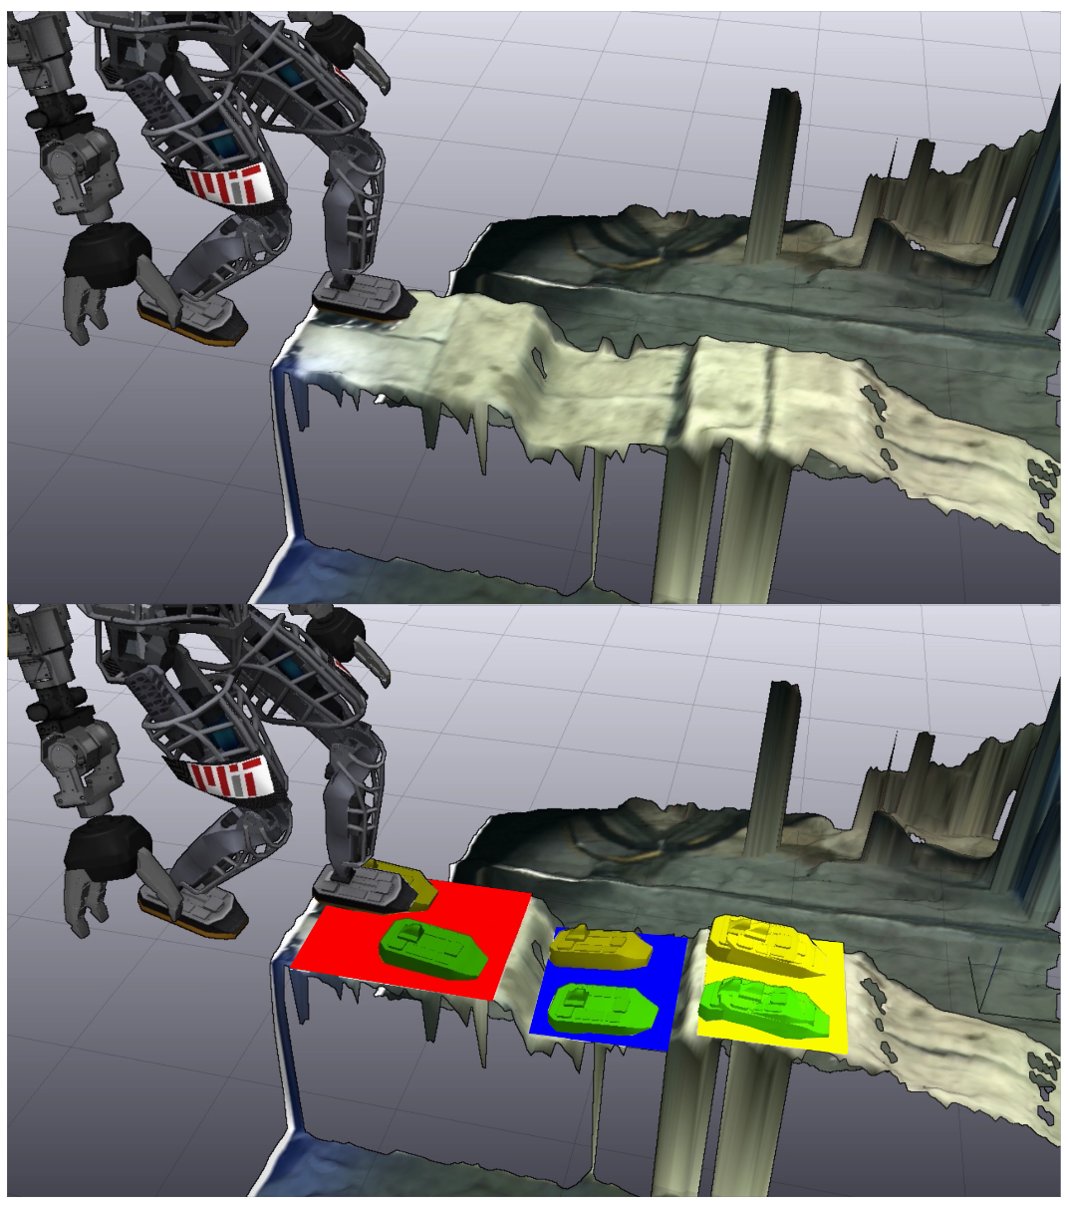
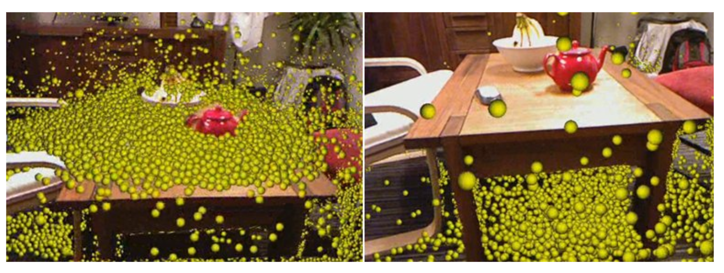
Completing 3D Scans: Applications
Augmented reality
Realistic global illumination
Accurate physical interaction
Content creation
High-quality, watertight reconstructions valuable
Robotics
Foot placement for walking robots
Planning grabbing operations
KinectFusion: Real-time dense surface mapping and tracking (Newcombe et al. ISMAR 2011)
Continuous Humanoid Locomotion over Uneven Terrain using Stereo Fusion (Fallon et al. IEEE-RAS International Conference on Humanoid Robots 2015)

Slide 7
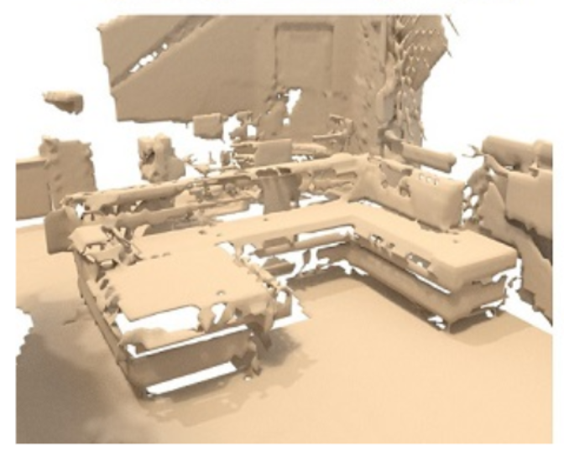
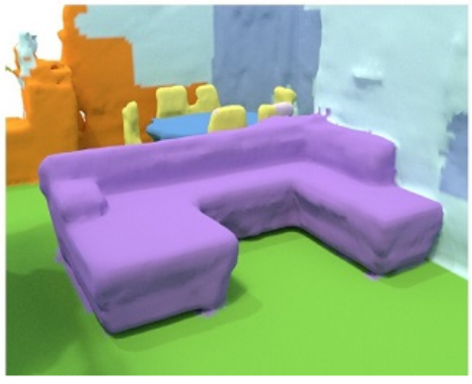
ScanComplete: Overview
Input: Incomplete TSDF reconstruction of indoor scene (geometry only)
Output: Complete TDF reconstruction with per-voxel semantic labels
Approach: Hierarchy of fully convolutional 3D CNNs
Training: Supervised, using synthetic data

Slide 8
Data Generation
Generated from SUNCG dataset
3D Geometry with semantic labelling
5359 training scenes, 155 test scenes
Generating TDFs comparatively simple
No sign since input meshes not watertight
Incomplete TSDFs generated by simulating scanning trajectories
Use ScanNet dataset (real RGBD + poses)
Start from plausible camera poses
Optimise trajectory based on
Similarity to ScanNet trajectories
Looking at “interesting” scene objects
http://suncg.cs.princeton.edu/

Slide 9
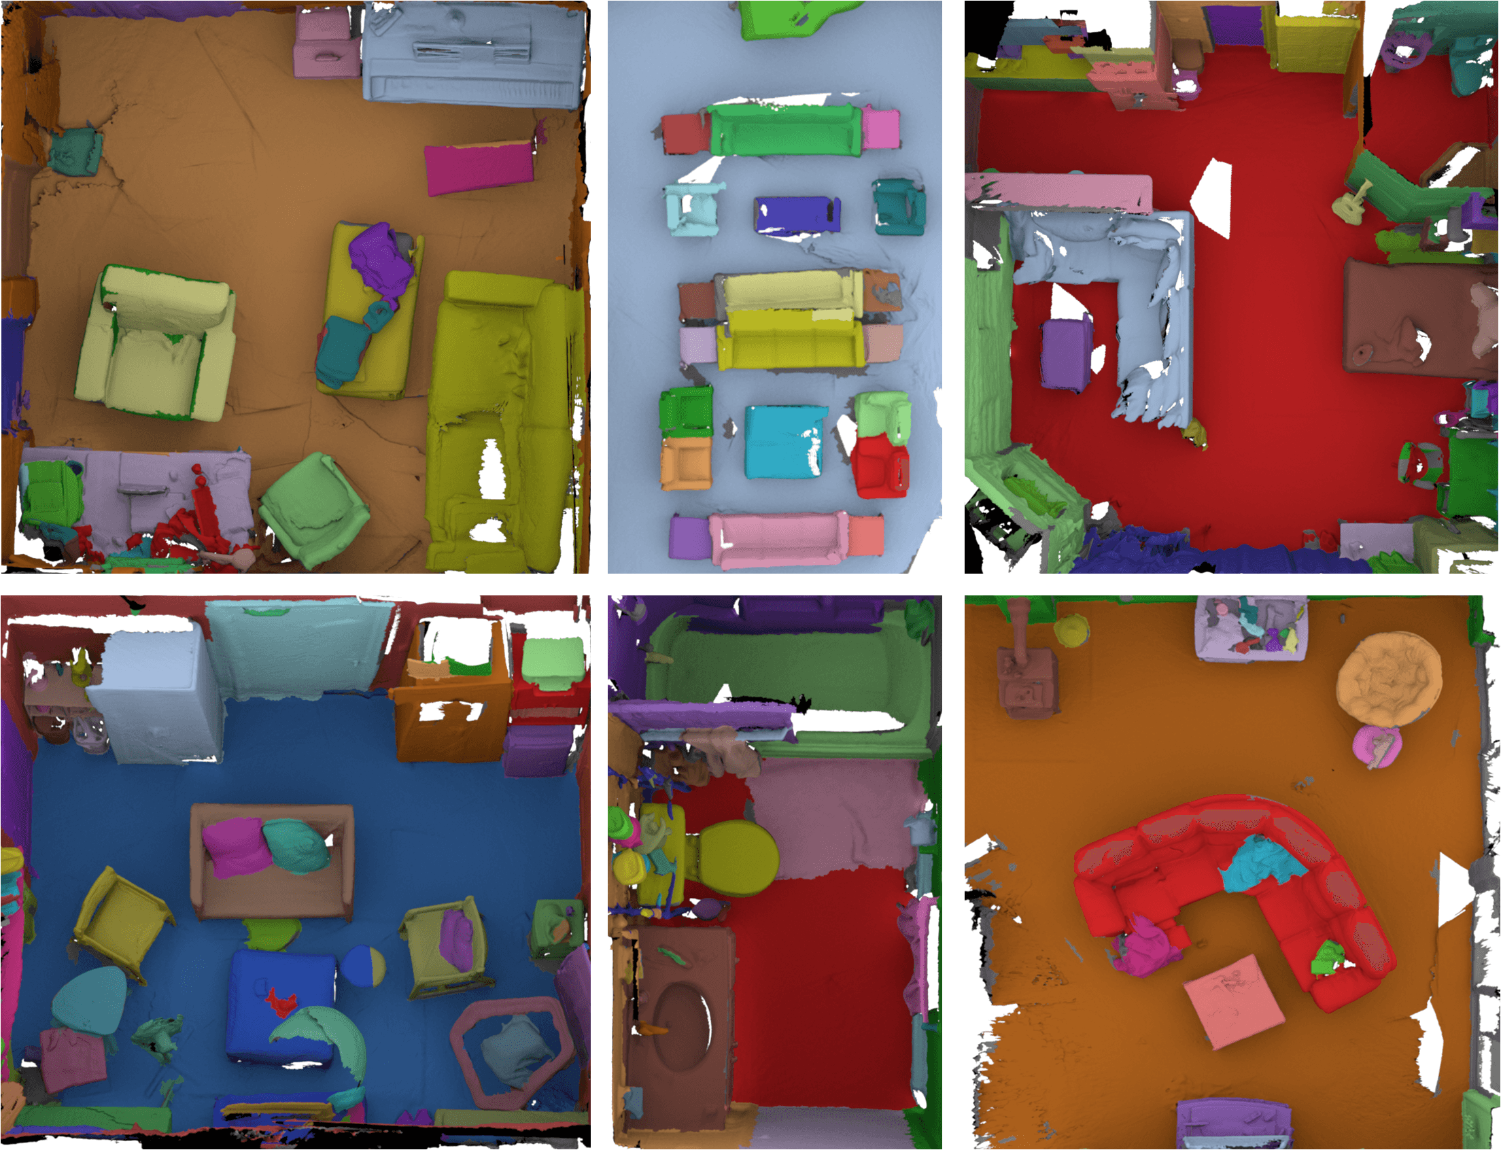
Trajectory Generation
At each 1.5m³ sub-volume, select one camera pose
Sample from distribution of angles, camera heights based on ScanNet
Choose pose minimising linear combination of:
Probability of depth histogram under Gaussian distribution from ScanNet
Percentage of pixels not classified as ground, floor, wall
Interpolate between selected poses to make trajectory
http://www.scan-net.org/
1500 scans, 707 locations
Semantic labelling (Mechanical Turk)

Slide 10
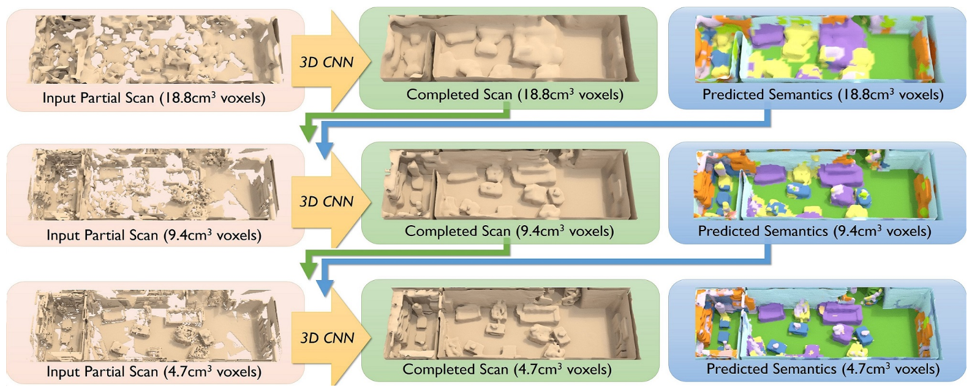
Coarse-to-fine Approach
Hierarchy of networks employed
Each operates on different voxel resolution
Each finer level conditioned on previous coarser level
Coarser levels capture spatial context over wider area
Finer levels allow reconstruction of finer details

Slide 11
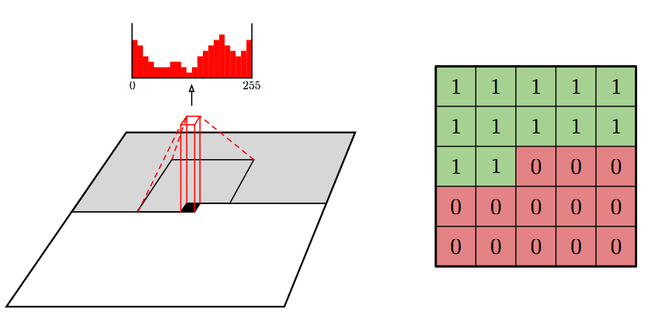
Autoregressive Architecture
Based on approach developed for PixelCNN
Conditional image generation
Original approach generates pixels sequentially
O(N), not parallelizable
Updated approach operates in coarse-to-fine way
Generate initial 4x4 image
Upscaling steps to increase resolution
Pixels within groups processed in parallel
O(log N)
Conditional Image Generation with PixelCNN Decoders (Oord et al. NIPS 2016)
Parallel Multiscale Autoregressive Density Estimation (Reed et al. ICML 2017)

Slide 12
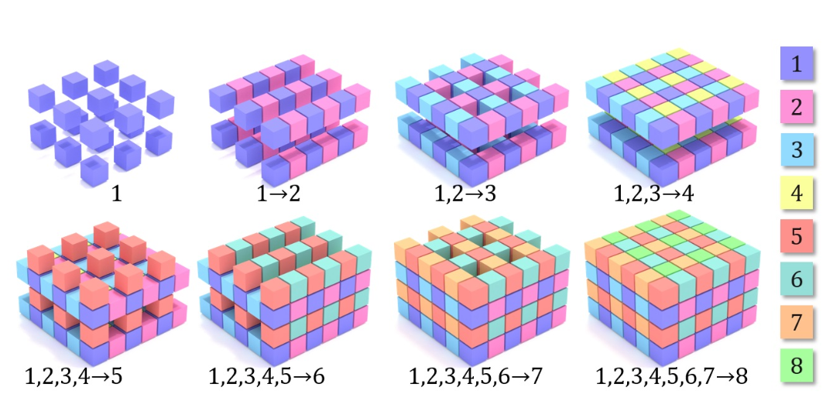
Autoregressive Architecture
ScanComplete applies approach in 3D
4 pixel groups -> 8 voxel groups
Output of each conditioned on predictions in previous groups
Separate CNN for each group
3*8=24 CNNs overall
Inference sequential, but training parallel, using ground truth input
Improved accuracy vs. treating voxels independently

Slide 13
Network Architecture

Slide 14
Network Architecture
Fully convolutional, operating directly in 3D
Invariant to training and testing data sizes
Input volumes are processed with 3D convolutions with 1x1x1 shortcuts
Then concatenated feature-wise, and further convolved with shortcuts
Network splits to provide separate geometric & semantic output
Geometric error: $ℓ_{1}$ loss on TDF values
Semantic error: Voxel-wise softmax cross entropy

Slide 15
Training Process
Inputs:
Input partial scan
Previous voxel groups: ground truth
Previous hierarchy level: actual network output
Using ground truth caused over-reliance on previous level
Led to overly smoothed output (no detail)
Height jittering to prevent overfitting
8 groups trained in parallel, 3 levels sequentially
Train on subvolumes sampled each 3m from training scenes
90% of volumes with only wall/ceiling/floor randomly discarded
Leaves ~200,000 subvolumes
~3 days training (GTX 1080)

Slide 16
Evaluation: Architecture Variants
Probabilistic/Deterministic
prob.: Outputs discrete distribution over quantized TDF values
det.: Single TDF output per voxel
Autoregressive
autoreg.: Uses autoregressive architecture (8 groups, conditioned on previous)
non-autoreg.: All voxels predicted independently
Errors:
Entire: Comparing whole target TDF volume
Predicted surface: Constrained to surfaces in predicted output
Target surface: Constrained to surfaces in ground truth
Unknown space: Constrained to complement of predicted surface

Slide 17
Evaluation: Architecture Variants

Slide 18
Evaluation: Real Data (ScanNet)

Slide 19
Evaluation: Semantic Accuracy
ScanNet:
3D semantic labelling CNN trained on ScanNet dataset.
Uses approach of Qi et al (Volumetric and Multi-View CNNs for Object Classification on 3D Data)
SSCNet:
Semantic Scene Completion: generates complete volumetric occupancy with semantic labels from single depth map
However, does this by first converting depth map to TSDF, allowing it to be compared
N.B. different output to ScanComplete – occupancy, not TDF (less geometric detail)

Slide 20
Timings (GTX 1080)

Slide 21
Conclusion
3D scan completion & semantic labelling
No limit on spatial extent
Hierarchy allows use of context at different scales
Further work:
Improved final output resolution (currently 5cm³)
End-to-end training (currently hierarchy levels trained separately)
Also:
Colour output
Code, trained models & test scenes available:
https://github.com/angeladai/ScanComplete

